Slide 1
Supply Chain Analysis:
A Comprehensive Analysis Using Power BI
By
NIMISHA Jyothi

Slide 2
OBJECTIVE:
To analyze and optimize the supply chain process by identifying key performance indicators (KPIs), monitoring inventory levels, evaluating supplier performance, and minimizing delivery delays using Power BI. The goal is to enhance operational efficiency, reduce costs, and improve customer satisfaction.
DATA SOURCE: Supply chain data
TOOLS USED: Power BI, DAX

Slide 3
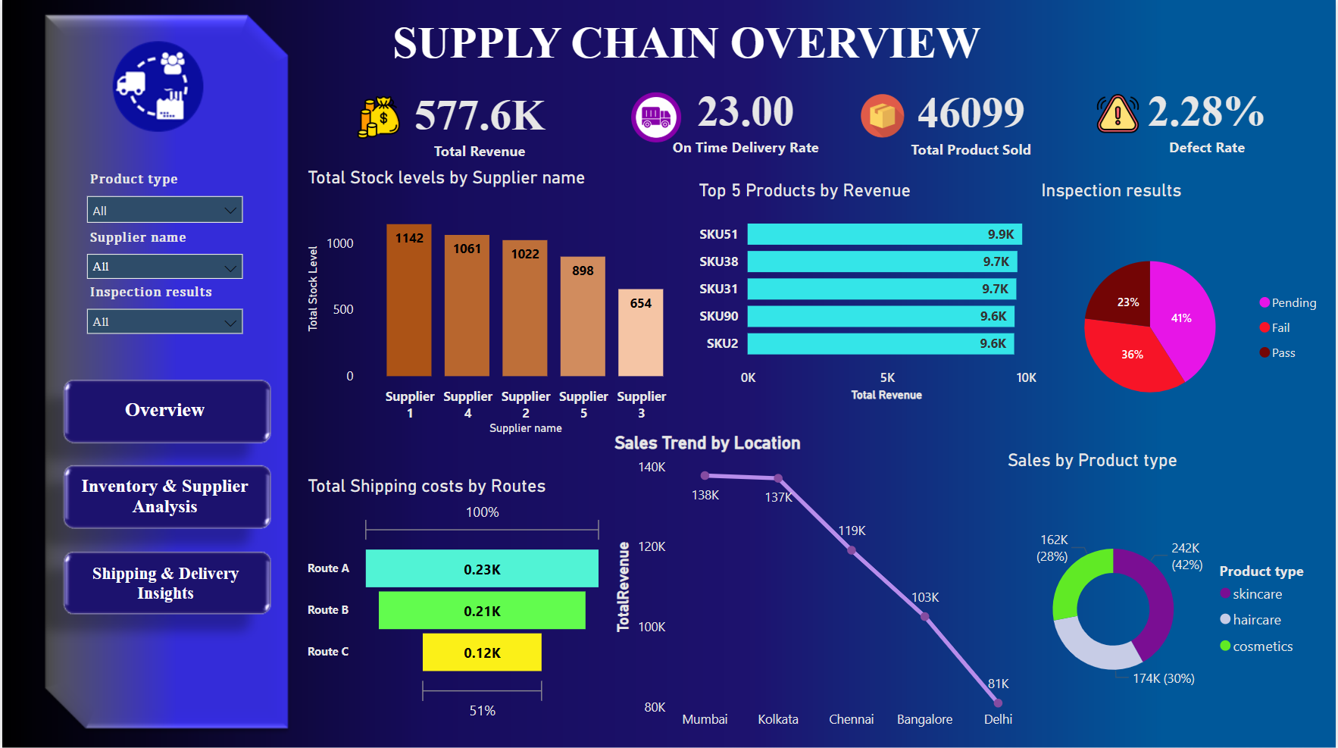

Slide 4
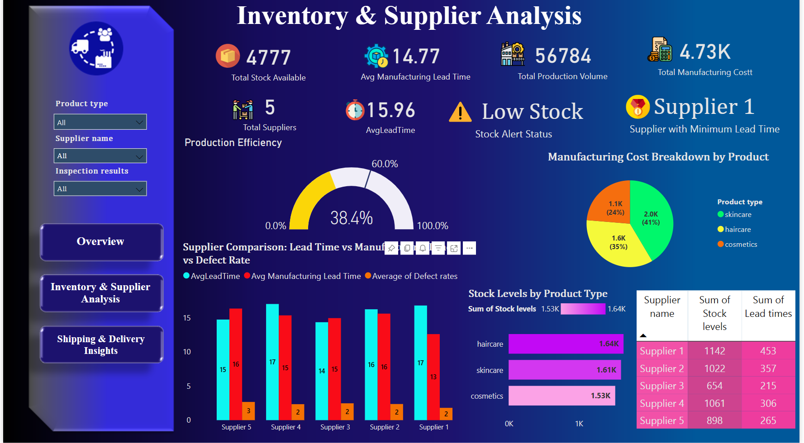

Slide 5
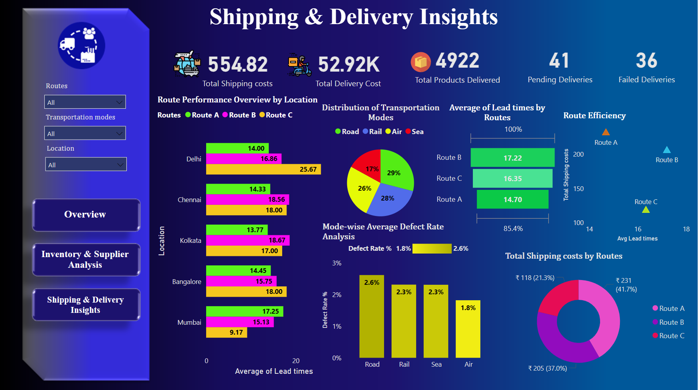

Slide 6
Challenges:
Low On-Time Delivery (23%) → Supply chain delays.
High Inspection Failure (36%) → Supplier quality issues.
Stock Imbalance → Supplier 3 has low inventory.
Sales Drop → Delhi & Bangalore underperforming.
High Shipping Costs → Route A is expensive.
Solutions:
Optimize logistics & supplier coordination.
Strengthen quality control to reduce failures.
Balance supplier stock levels.
Boost marketing & distribution in weak locations.
Optimize shipping routes to cut costs.

Slide 7
Manufacturing & Supply Issues:
Stock Shortages & High Lead Time (15.96 days).
Supplier 1 is the fastest but faces stock issues.
Defect rate varies by supplier.
Skincare has the highest production cost (41%).
Solutions:
Optimize inventory & supplier orders.
Reduce lead time via better supplier coordination.
Improve supplier quality & performance.
Control production costs efficiently.

Slide 8
Shipping & Delivery Challenges:
High Costs (₹54.82K shipping, ₹52.92K delivery).
41 Pending & 36 Failed Deliveries.
Route B is slow (17.22 days) & expensive.
Road transport defect rate (2.6%).
Solutions:
Optimize delivery routes & reduce reliance on Route B.
Improve failed deliveries through logistics enhancements.
Minimize transport defects with better handling.
Focus on Route A for lower lead time & moderate cost.

Slide 9
Power BI Dashboard Link:
Supply Chain Analysis
LinkedIn Link:
Nimisha Jyothi

Slide 10
Conclusion
The Power BI supply chain analysis highlights key inefficiencies, including delivery delays, high inspection failure rates, stock imbalances, and rising shipping costs. By leveraging data-driven insights, we can optimize logistics, enhance supplier performance, balance inventory levels, and reduce costs. Implementing these strategies will improve operational efficiency, minimize risks, and drive better decision-making, ensuring a more resilient and cost-effective supply chain.

